Slide 1
Fruit Quality Detection

Slide 2
agenda
Objective
Installation & setup required for model training
How to run pre-trained YOLO out-of-the-box and get results
How to train your custom YOLO object detection model
Dataset & annotations
Conclusions

Slide 3
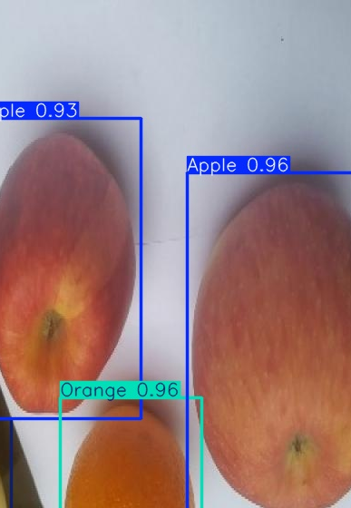
Detecting objects is a task that needs a complex solution. For a computer to “detect objects” means to process an input image (or a single frame from a video) and respond with information about objects on the image and their position. In computer vision terms, we call these two tasks classification and localization. We want the computer to say what kind of objects are presented on a given image and where exactly they’re located.
Objective

Slide 4
Installation & setup required for model training
Let’s talk about the prerequisites that are essential to create our own object detector:
Python already installed on our computer.
Setup the GPU In our Environment.
This requires TensorFlow and relevant libraries.
As for me, I was building and training my YOLOv11 model in a Google Colab development environment.

Slide 5
How to run pre-trained YOLO out-of-the-box and get results
we just have to import YOLO as a class object and load in the model weights.
Note that we need to manually download model weights in advance. The model weights file that comes with YOLO comes from the COCO dataset.
Right after, the model is fully ready to work with images in inference mode. Just use the predict() method for an image of your choice. The method is standard for TensorFlow and Keras frameworks.
There are multiple parameters within the predict() method that let us specify whether we want to plot the image with the predicted bounding boxes, textual names for each object, etc.

Slide 6
effective delivery techniques
Effective body language enhances your message, making it more impactful and memorable:
Meaningful eye contact
Purposeful gestures
Maintain good posture
Control your expressions
This is a powerful tool in public speaking. It involves varying pitch, tone, and volume to convey emotion, emphasize points, and maintain interest:
Pitch variation
Tone inflection
Volume control

Slide 7
How to train custom YOLO object detection model
To design an object detection model, we need to know what classes we want to detect. This should be a limited number of classes that we want to create your detector for. It’s good to have a list of classes prepared as we move to the actual model development.
Ideally, we should also have an annotated dataset that has objects of your interest. This dataset will be used to train a detector and validate it.

Slide 8

Dataset & annotations
I downloaded the dataset from roboflow, in that there are so many types of datasets.
My dataset contains Apple, Banana, Orange as Classes.
The dataset related to YOLOv11. I directly downloaded the dataset from code.

Slide 9
How to annotate data for YOLO
If dataset of images comes without annotations, we must do the annotation job. This manual operation is quite time-consuming, so make sure you have enough time to do it.
I use the LabelImg for labeling the dataset.
After Labeling I created requirements and classes which is in yaml format.

Slide 10
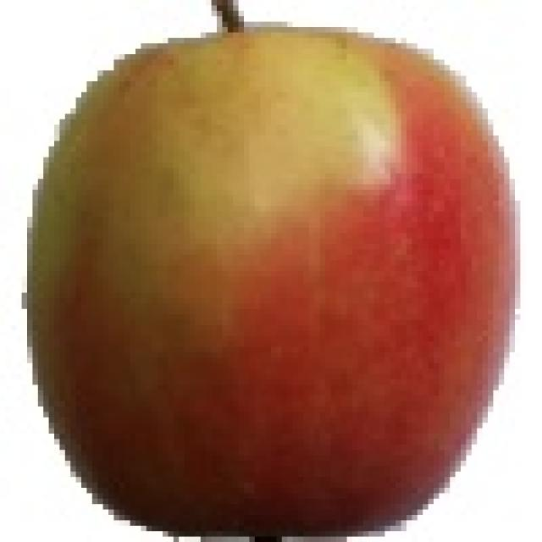
Prerequisites
By now We have:
A splited dataset
Two data generators initialized
A txt file with the classes.

Slide 11
Model training
I used the Yolo11 model to object detection.
First I trained the model using training dataset
After that I validated the model using validation dataset
After checking the results I tested the model using test dataset

Slide 12
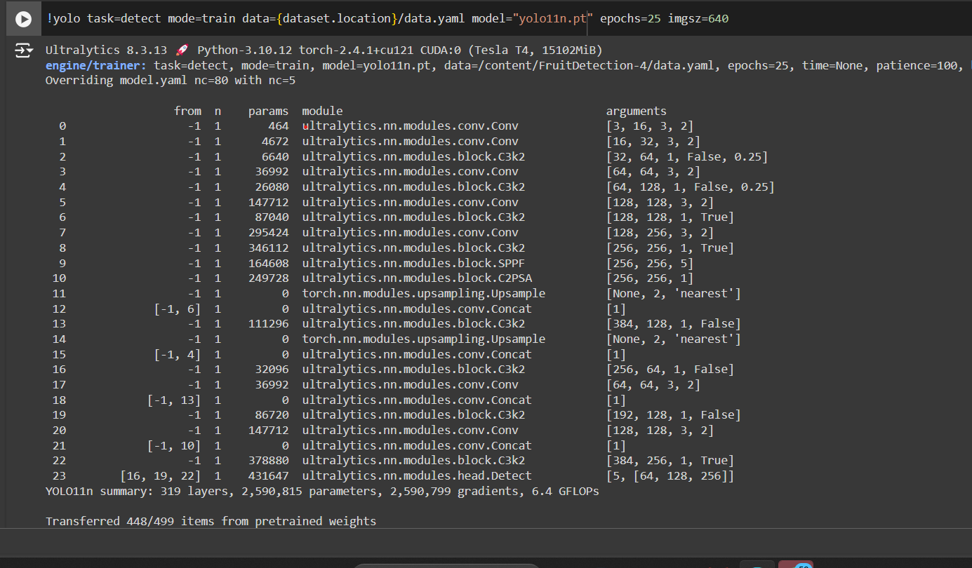

Slide 13
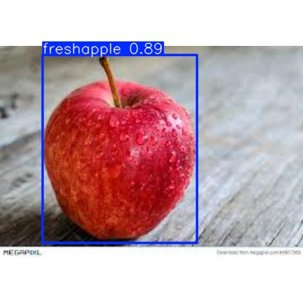
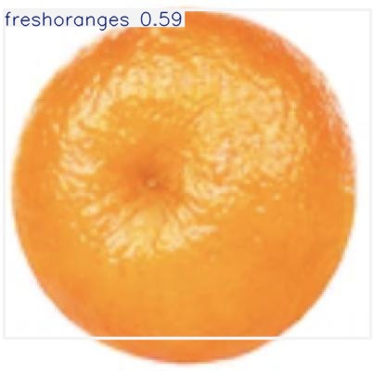
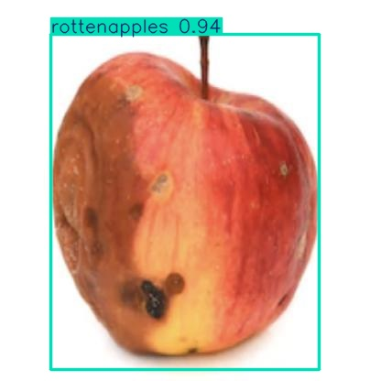
Predicted images

Slide 14
thank you
BALAKRISHNA
9885036899
bk1583829@gmail.com

